Slide 1
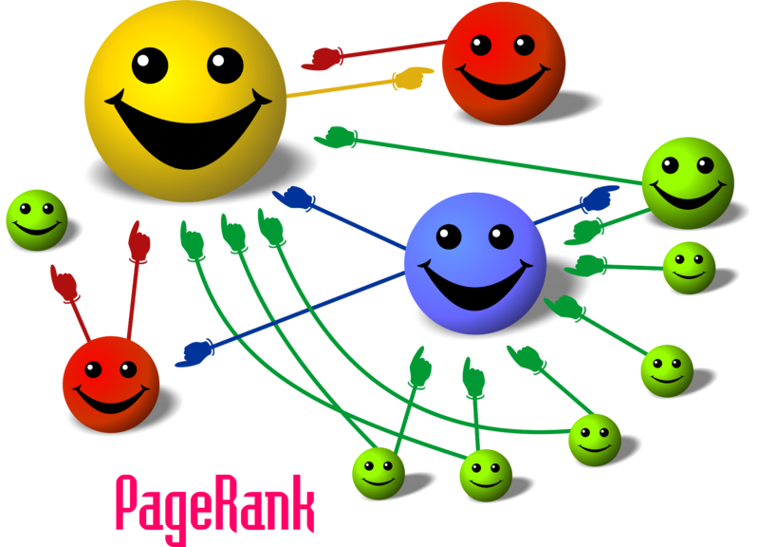

Slide 2
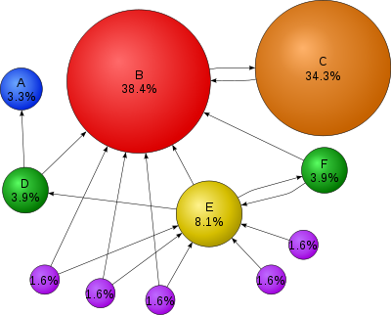
PageRank
PAGE RANK (determines the importance of webpages based on link structure)
PageRank is a probability distribution used to represent the likelihood that a person randomly clicking on links will arrive at any particular page.
Also see: http://infolab.stanford.edu/~backrub/google.html (original PageRank paper)

Slide 3
PageRank: the intuitive idea
PageRank relies on the democratic nature of the Web by using its vast link structure as an indicator of an individual page's value or quality.
PageRank interprets a hyperlink from page x to page y as a vote, by page x, for page y.
However, PageRank looks at more than the sheer number of votes; it also analyzes the page that casts the vote.
Votes casted by “important” pages weigh more heavily and help to make other pages more "important."
This is exactly the idea of rank prestige in social network.

Slide 4
More specifically
A hyperlink from a page to another page is an implicit conveyance of authority to the target page.
The more in-links that a page i receives, the more prestige the page i has.
Pages that point to page i also have their own prestige scores.
A page of a higher prestige pointing to i is more important than a page of a lower prestige pointing to i.
In other words, a page is important if it is pointed to by other important pages.

Slide 5
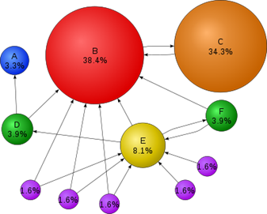

Slide 6
The original PageRank™ algorithm
PR(A) = (1-d) + d (PR(T1)/C(T1) + ... + +PR(Tn)/C(Tn))
Where:
PR(A) is the PageRank of page A,
PR(Ti) is the PageRank of pages Ti which link to page A,
C(Ti) is the number of outbound links on page Ti
d is a damping factor which can be set between 0 and 1.

Slide 7
PR(T1)/C(T1) + ... + PR(Tn)/C(Tn)
The PageRank™ of pages Ti which link to page A does not influence the PageRank™ of page A uniformly.
The PageRank™ of a page T is always weighted by the number of outbound links C(T) on page T.
Which means that the more outbound links a page T has, the less will page A benefit from a link to it on page T.

Slide 8
PR(T1)/C(T1) + ... + PR(Tn)/C(Tn)
The weighted PageRank™ of pages Ti is then added up. The outcome of this is that an additional inbound link for page A will always increase page A's PageRank™.

Slide 9
PR(A) = (1-d) + d * (PR(T1)/C(T1) + ... + PR(Tn)/C(Tn))
After all, the sum of the weighted PageRanks of all pages Ti is multiplied with a damping factor d which can be set between 0 and 1. Thereby, the extend of PageRank benefit for a page by another page linking to it is reduced.

Slide 10
The Random Surfer Model
PageRank™ is considered as a model of user behaviour, where a surfer clicks on links at random with no regard towards content.
The random surfer visits a web page with a certain probability which derives from the page's PageRank.
The probability that the random surfer clicks on one link is solely given by the number of links on that page.
This is why one page's PageRank is not completely passed on to a page it links to, but is devided by the number of links on the page.

Slide 11
The Random Surfer Model (2)
So, the probability for the random surfer reaching one page is the sum of probabilities for the random surfer following links to this page.
This probability is reduced by the damping factor d. The justification within the Random Surfer Model, therefore, is that the surfer does not click on an infinite number of links, but gets bored sometimes and jumps to another page at random.

Slide 12
The damping factor d
The probability for the random surfer not stopping to click on links is given by the damping factor d, which depends on probability therefore, is set between 0 and 1
The higher d is, the more likely will the random surfer keep clicking links. Since the surfer jumps to another page at random after he stopped clicking links, the probability therefore is implemented as a constant (1-d) into the algorithm.
Regardless of inbound links, the probability for the random surfer jumping to a page is always (1-d), so a page has always a minimum PageRank.

Slide 13
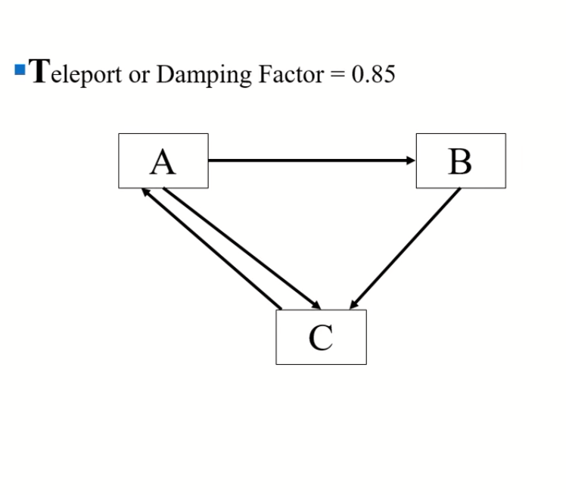
Example

Slide 14
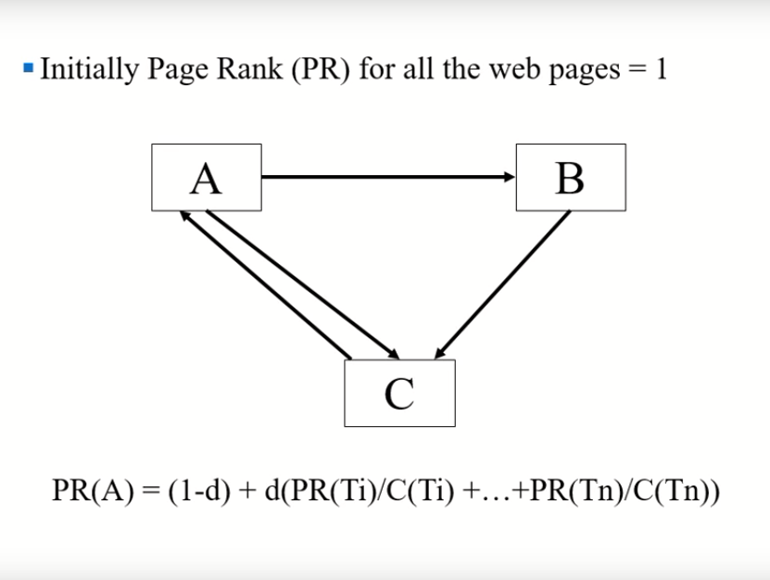

Slide 15
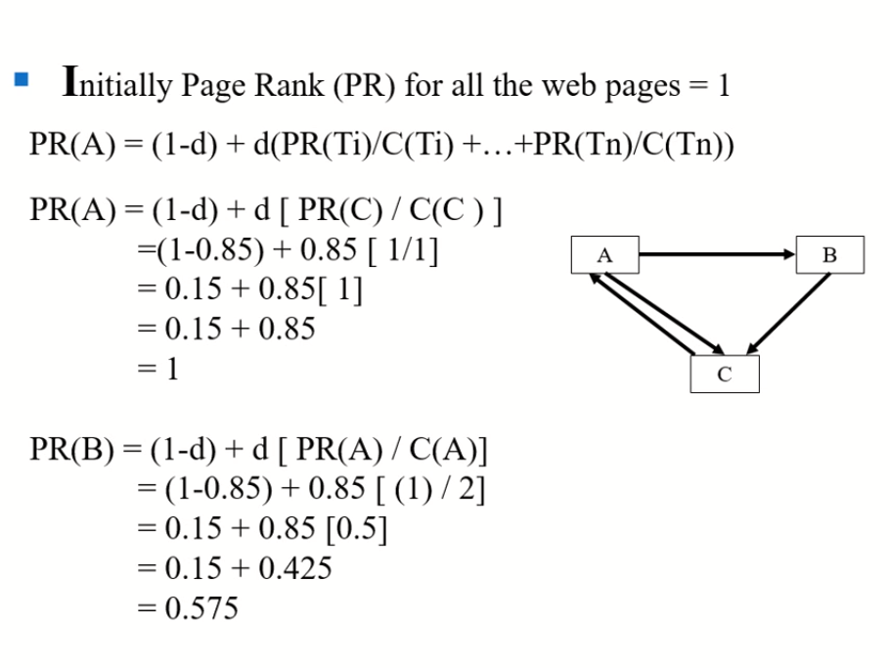

Slide 16
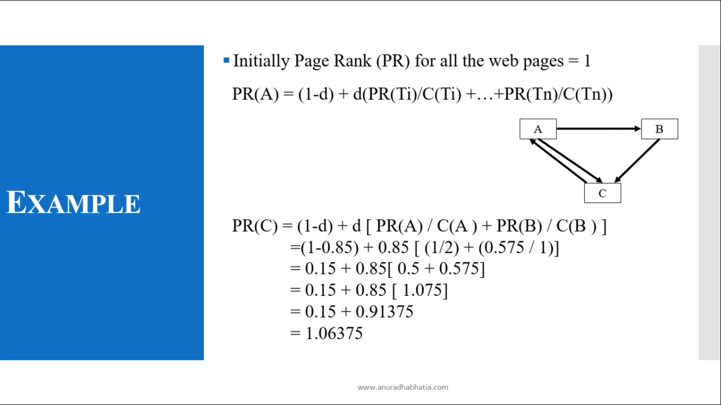

Slide 17
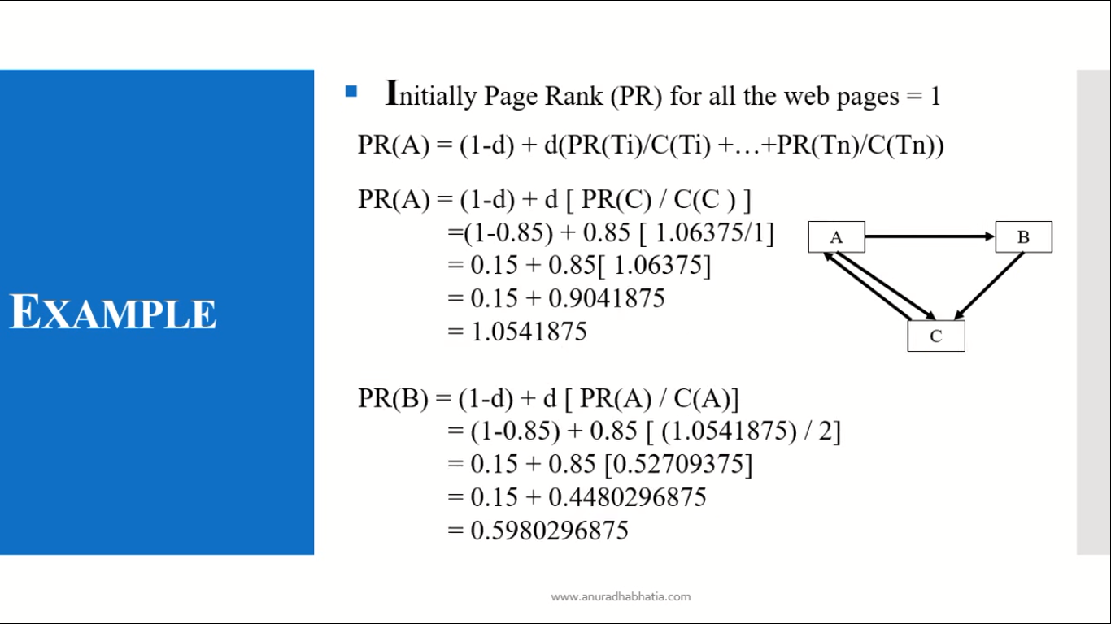

Slide 18
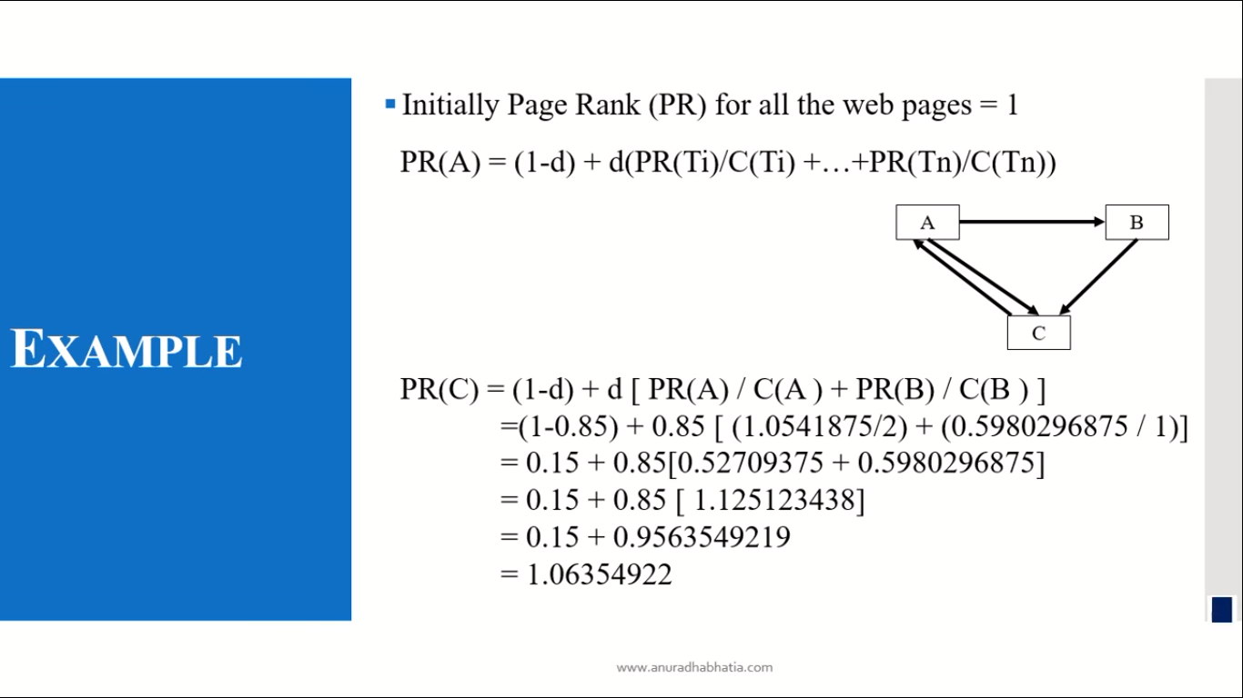

Slide 19
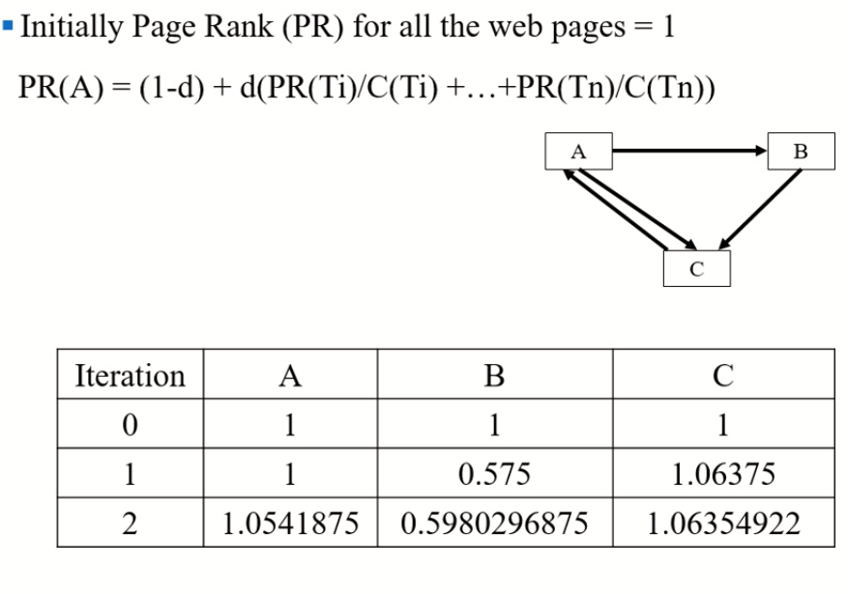

Slide 20
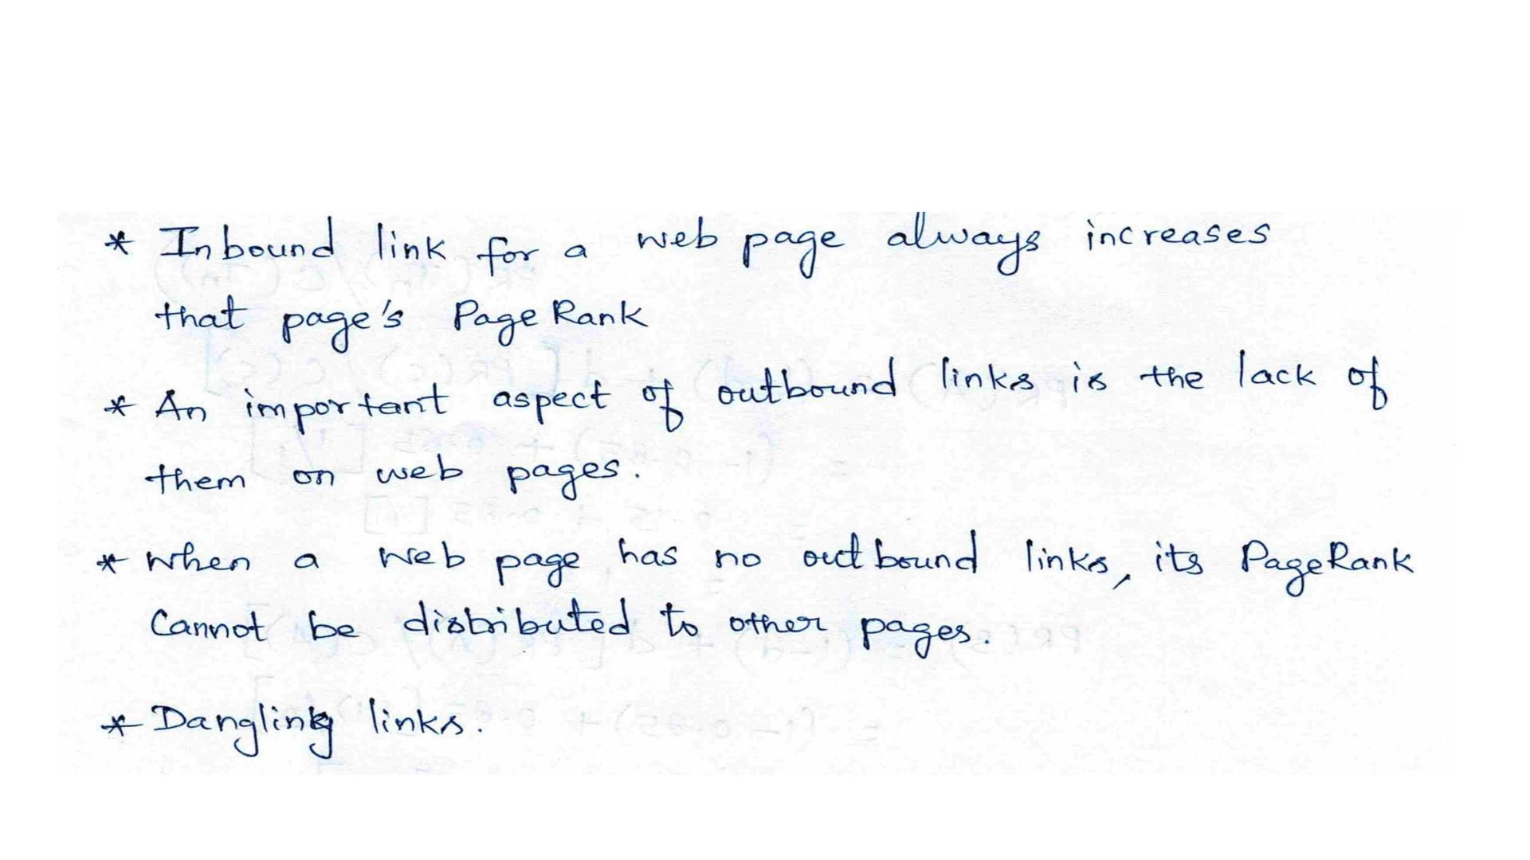

Slide 21
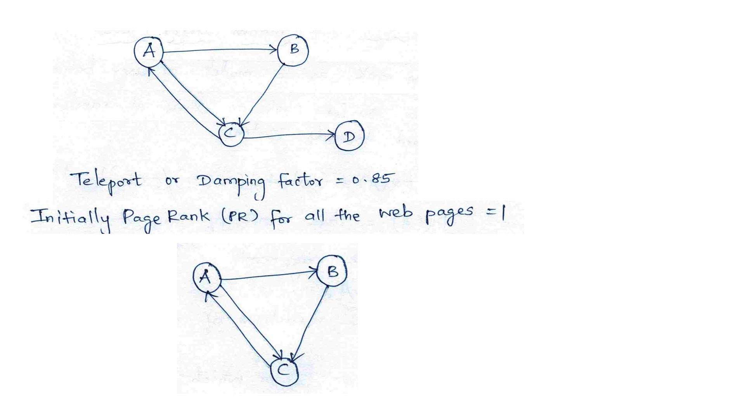

Slide 22
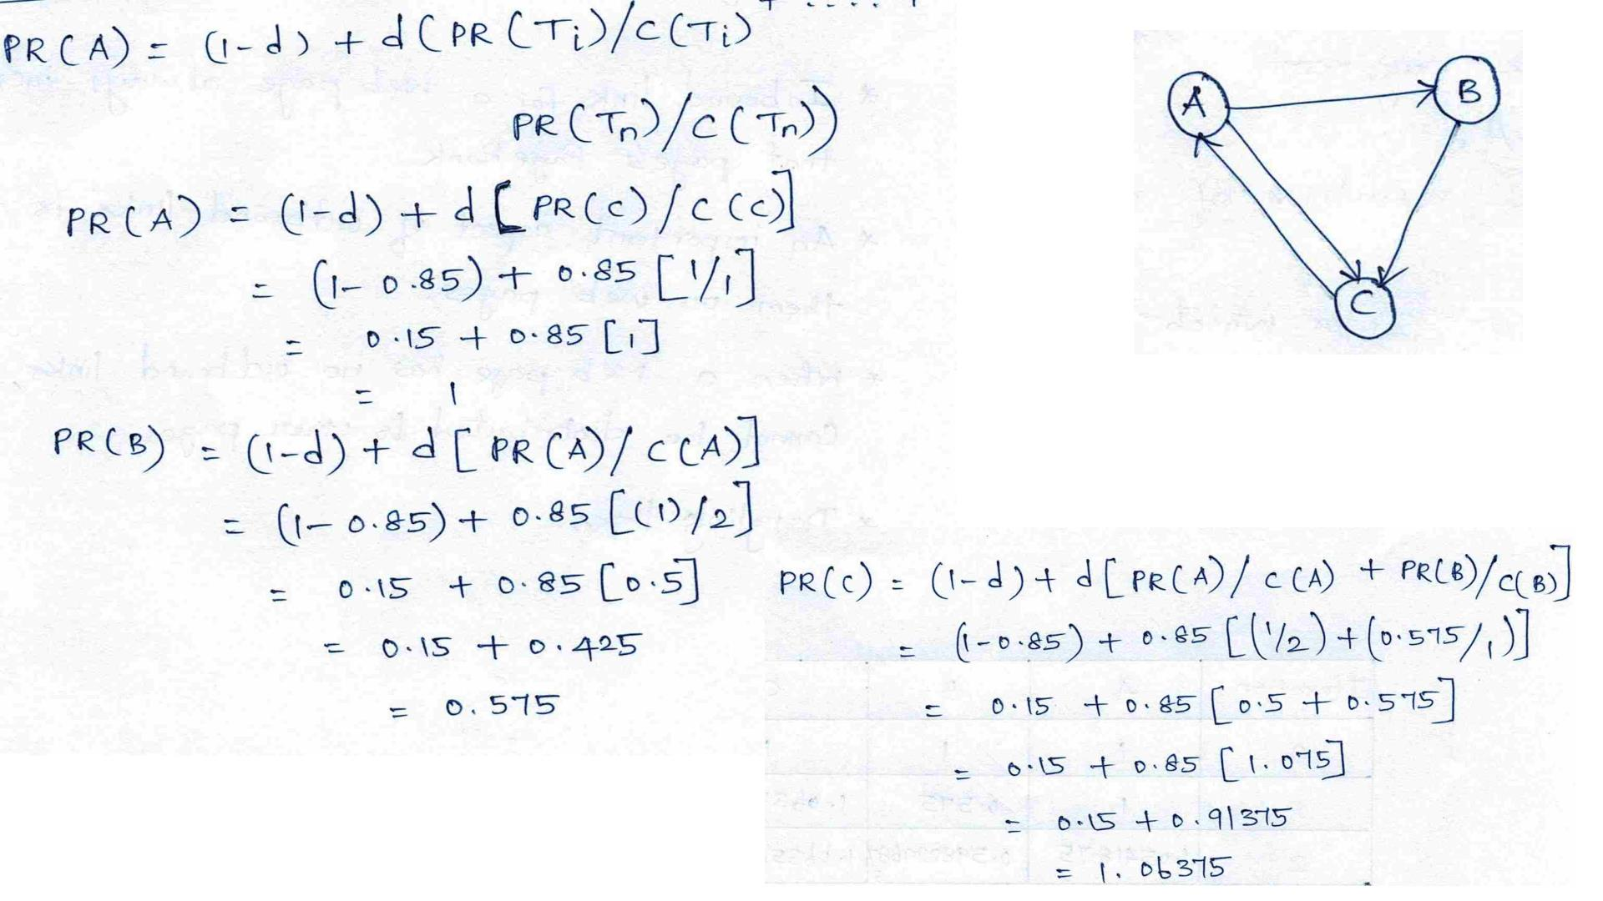

Slide 23
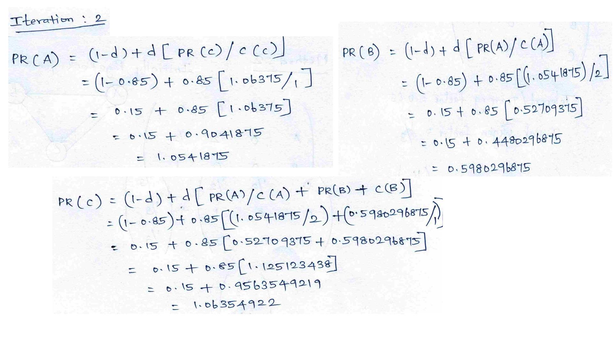

Slide 24
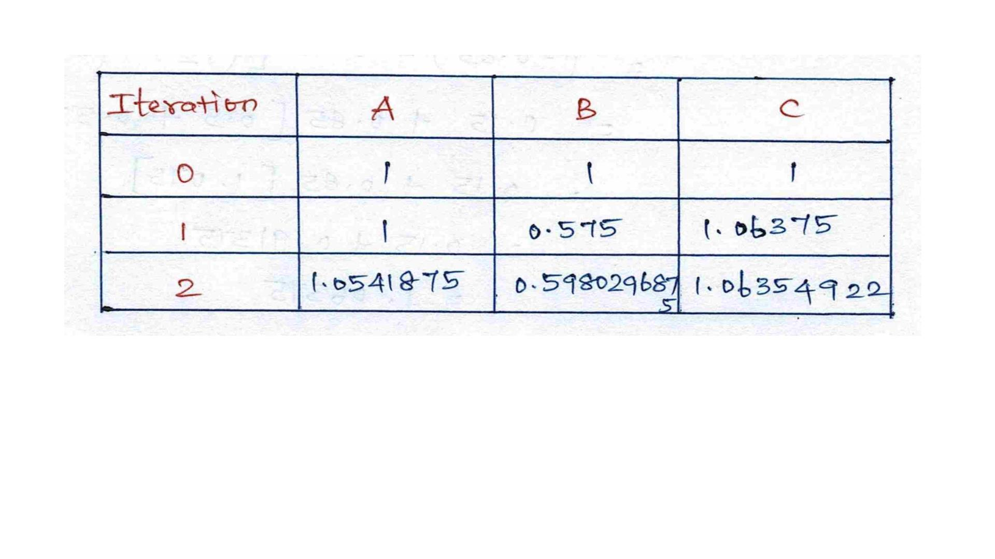

Slide 25
Hypertext Induced Topic Search

Slide 26
HITS
HITS stands for Hypertext Induced Topic Search.
Unlike PageRank which is a static ranking algorithm, HITS is search query dependent.
When the user issues a search query,
HITS first expands the list of relevant pages returned by a search engine and
then produces two rankings of the expanded set of pages, authority ranking and hub ranking.

Slide 27
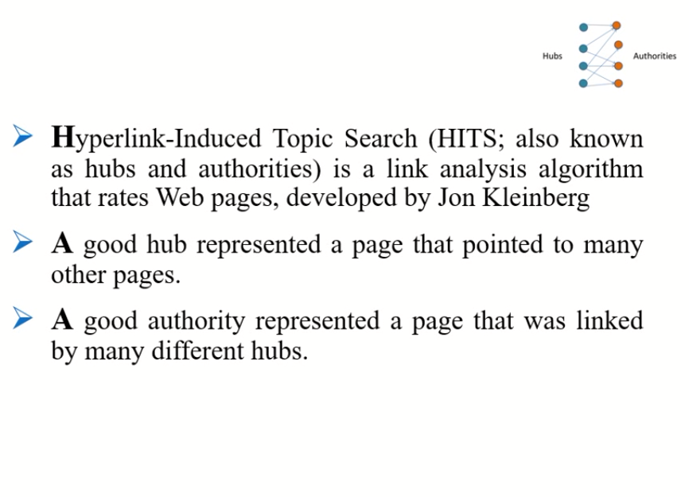

Slide 28
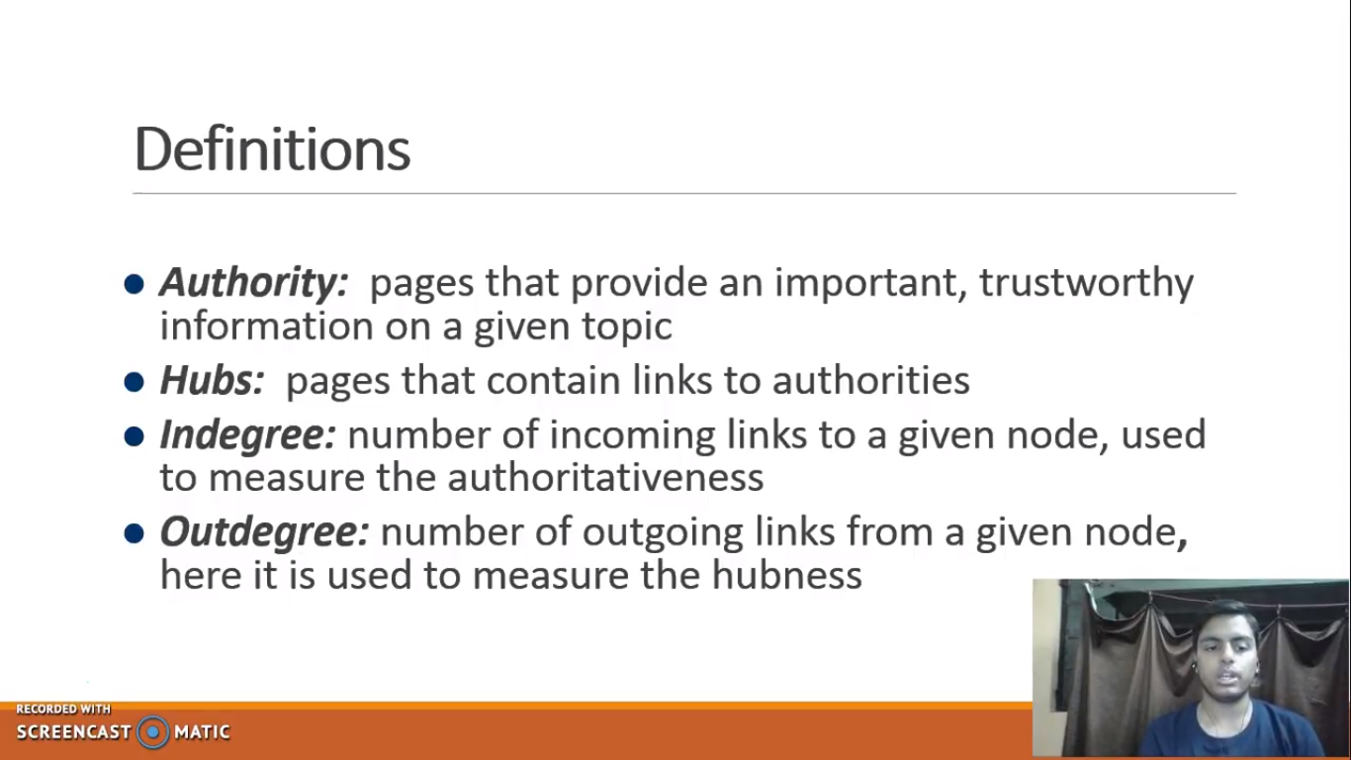

Slide 29
Authorities and Hubs
Authority: Roughly, a authority is a page with many in-links.
The idea is that the page may have good or authoritative content on some topic and a thus many people trust it and link to it.
Page i is called an authority for the query “automobile makers” if it contains valuable information on the subject
Hub: A hub is a page with many out-links.
The page serves as an organizer of the information on a particular topic and
points to many good authority pages on the topic.
Their role is to advertise the authoritative pages.

Slide 30
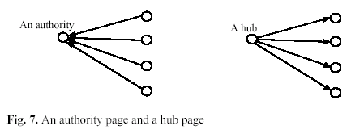
Examples

Slide 31
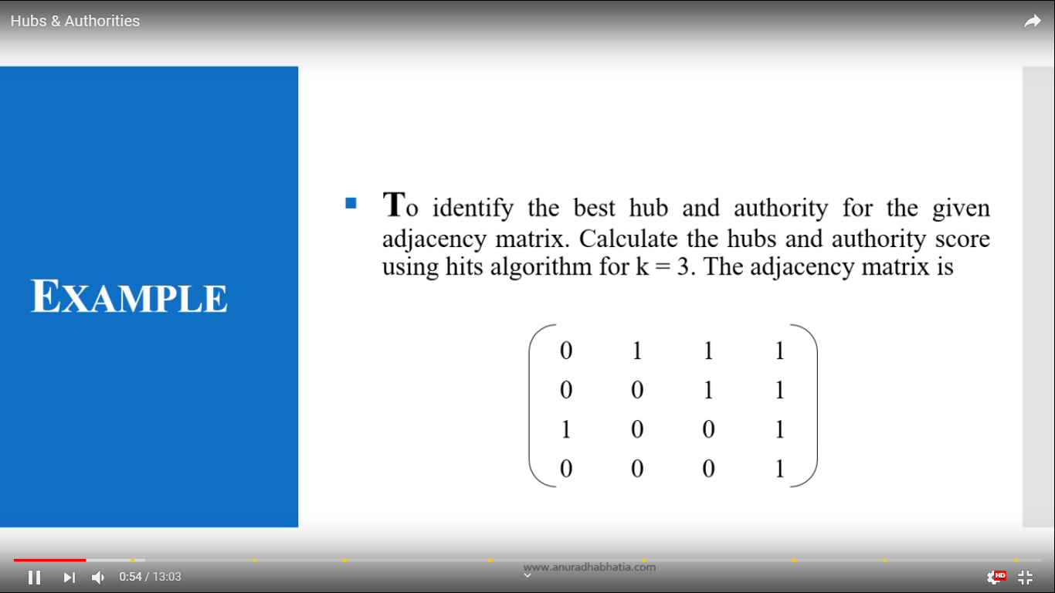

Slide 32
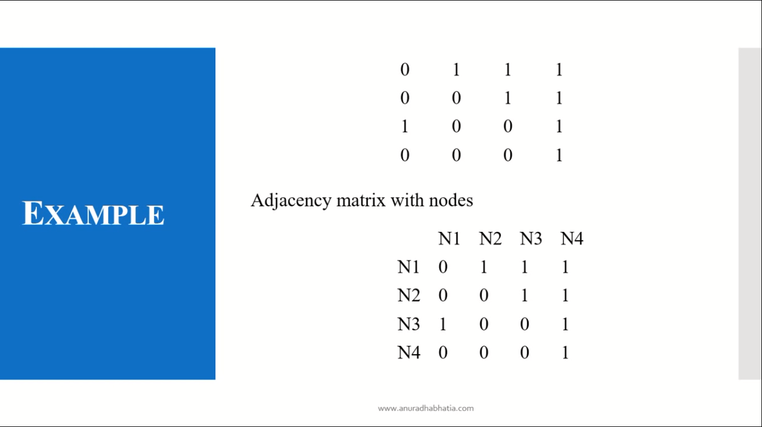

Slide 33
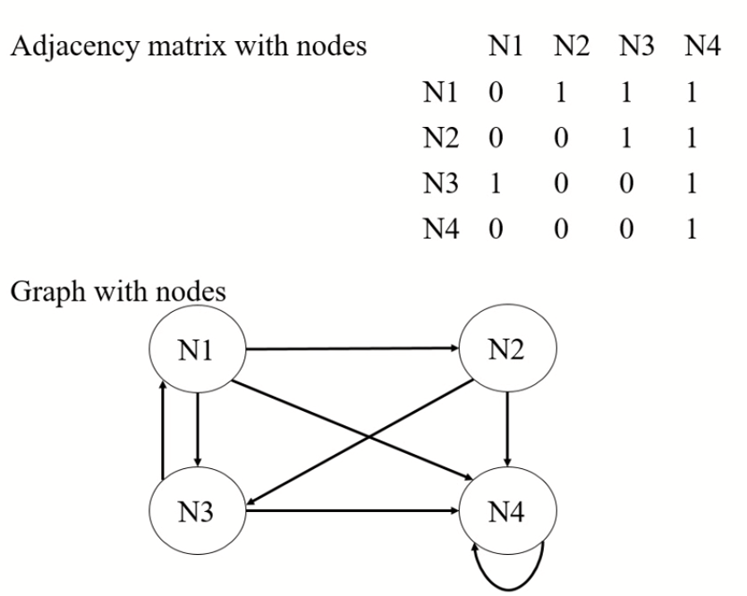

Slide 34
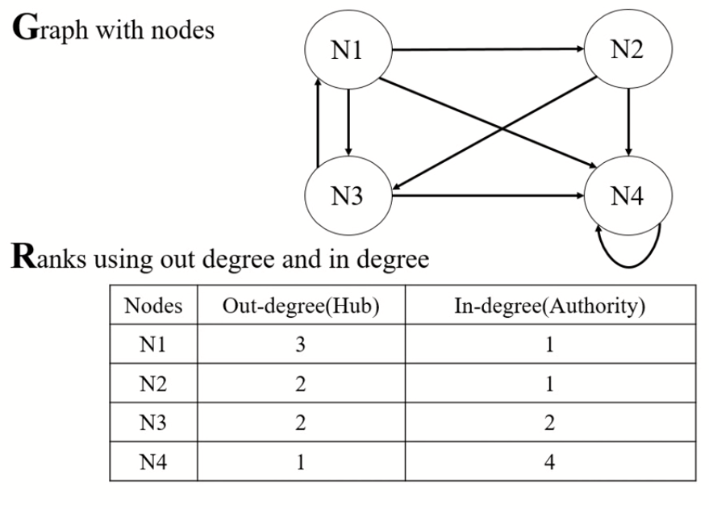

Slide 35
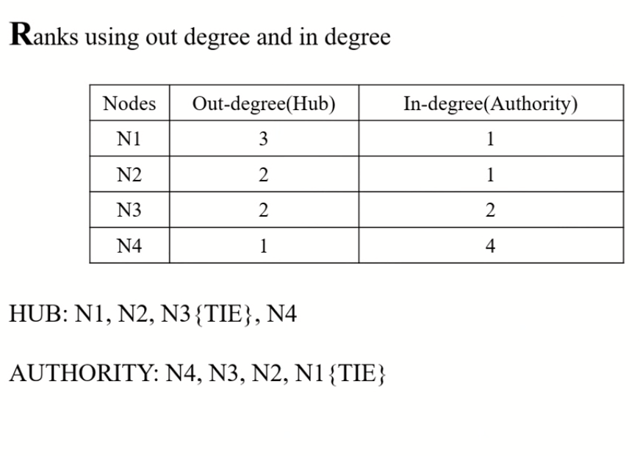

Slide 36
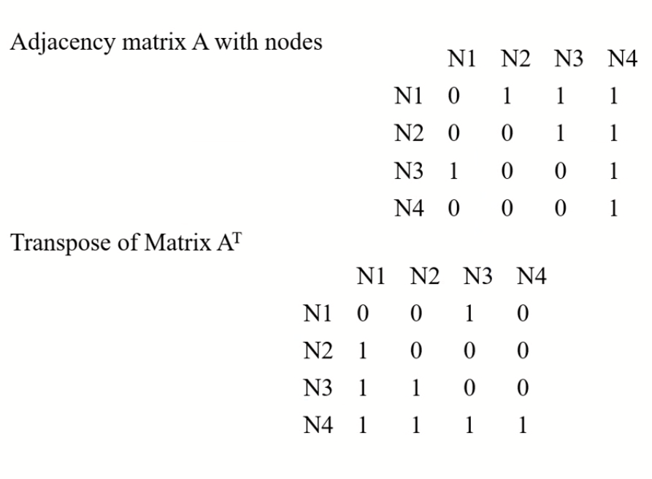

Slide 37
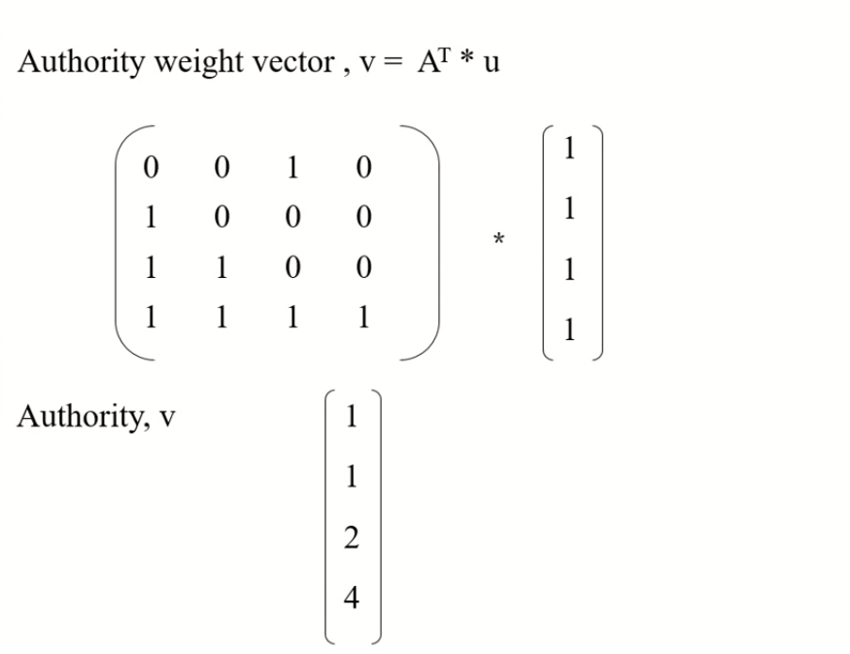

Slide 38
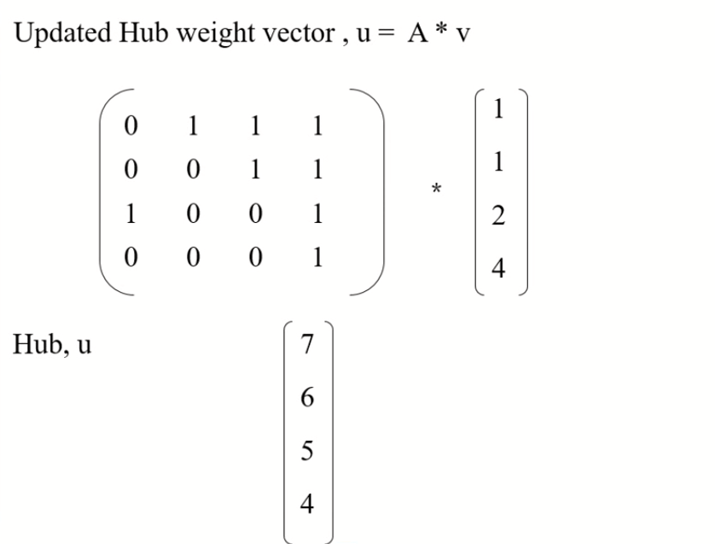

Slide 39
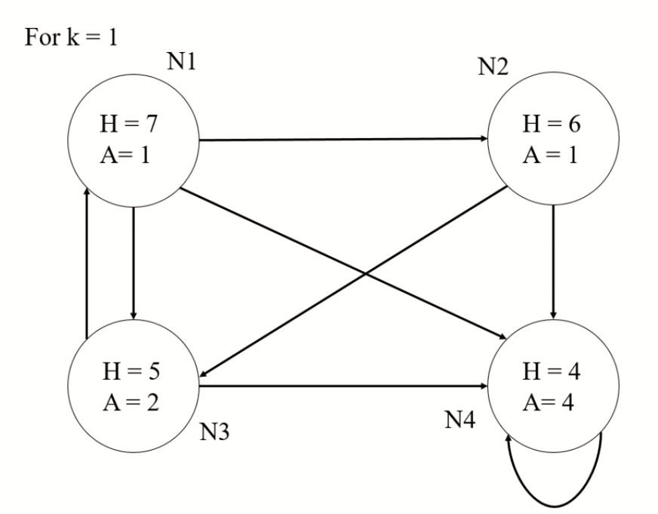

Slide 40
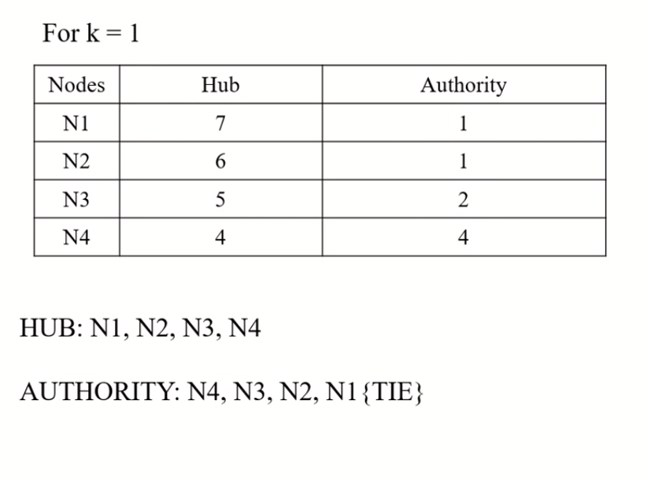

Slide 41
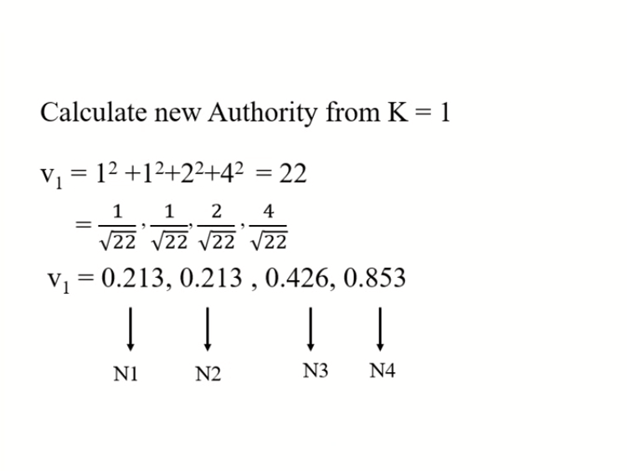

Slide 42
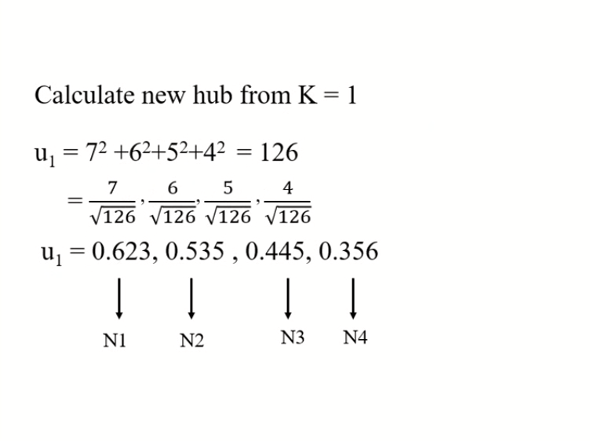

Slide 43


Slide 44
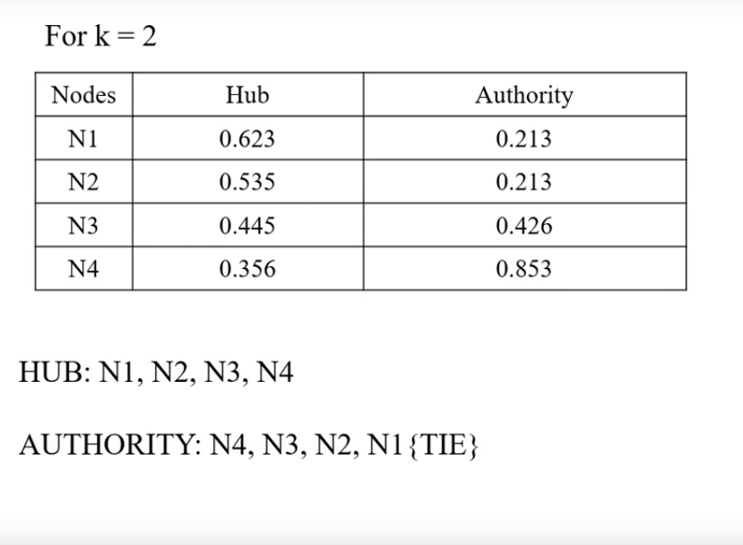

Slide 45
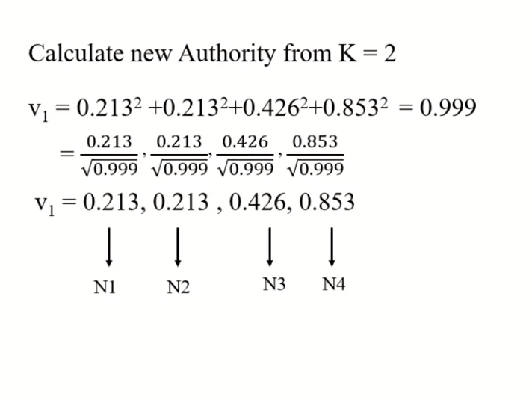

Slide 46
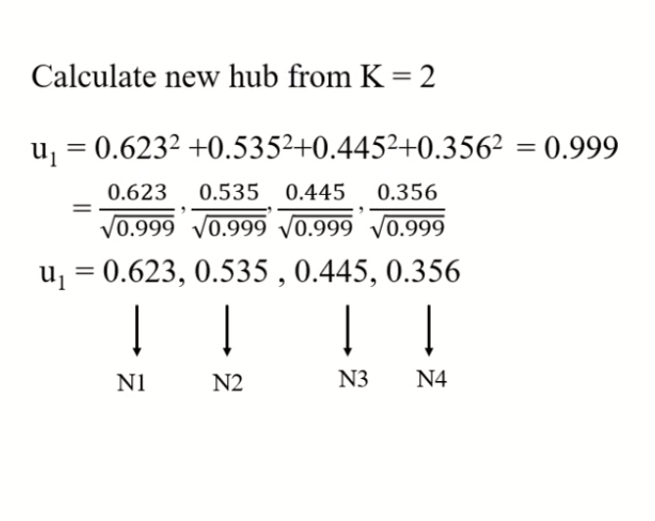

Slide 47


Slide 48
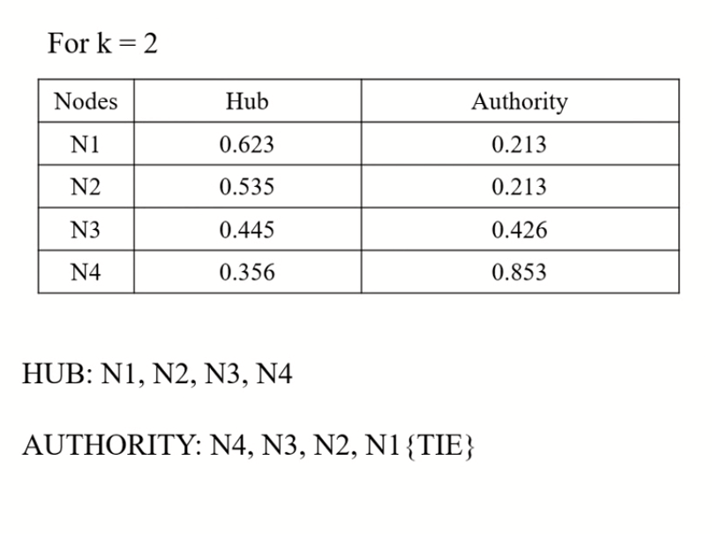

Slide 49


Slide 50


